Slide 1




INFO GATHERING
@GENERAL ZODX
START SLIDE
ZODFROMDEEPWEB.COM
SLIDE
01

Slide 2

ZODFROMDEEPWEB.COM
Basic
Analysis
BZU is using plesk services. A domain found useful was bzu.controloye.com (nginx and ubuntu)
A management person was found during scans who can a good victim for social engineering.
German IPs are giving cover to the site for it’s protection.
Mail servers are of dakbabu.
Target
bzu.edu.pk
SLIDE
02

Slide 3


ZODFROMDEEPWEB.COM
IP Network Information
Handle: 178.63.148.224 - 178.63.148.239
Status:
active
Address Range: 178.63.148.224 - 178.63.148.239
IP version: v4
Name: HOS-383610
Type: ASSIGNED PA
Country Code: DE
Parent Handle: 178.63.0.0 - 178.63.255.255
Whois Server: whois.ripe.net
Dates
Registration: 2020-01-28 02:31:49 UTC
Last changed: 2024-02-22 10:02:04 UTC
SLIDE
03

Slide 4

ZODFROMDEEPWEB.COM
SLIDE
04
Administrative:Handle: AF15513-RIPE
Name: Abdullah Faheem
Phone: +923008414341
Kind: individual
Mailing Address: CAT Marketing Systems, 29 - Queens Road, 54500 Lahore, PAKISTAN
Registrant:Handle: HOS-GUN
Name: HOS-GUN
Kind: individual
Possible
Social
Engineering
Victims
Abuse:Handle: HOAC1-RIPE
Name: Hetzner Online GmbH - Contact Role
Organization: ORG-HOA1-RIPE
Email: abuse@hetzner.com
Phone: +49 9831 505-0
Fax: +49 9831 505-3
Kind: group
Mailing Address: Hetzner Online GmbH, Industriestrasse 25, D-91710 Gunzenhausen, Germany
Technical:Handle: DD15478-RIPE
Name: Dennis Diehm
Phone: +4998315050
Fax: +4998315053
Kind: individual
Mailing Address: Hetzner Online GmbH, Industriestrasse 25, D-91710 Gunzenhausen, Germany
Motives
Dig a bit deep and gather a bit more info regarding the site.

Slide 5
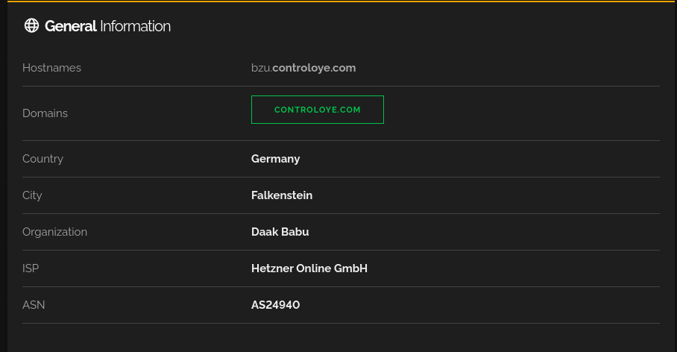
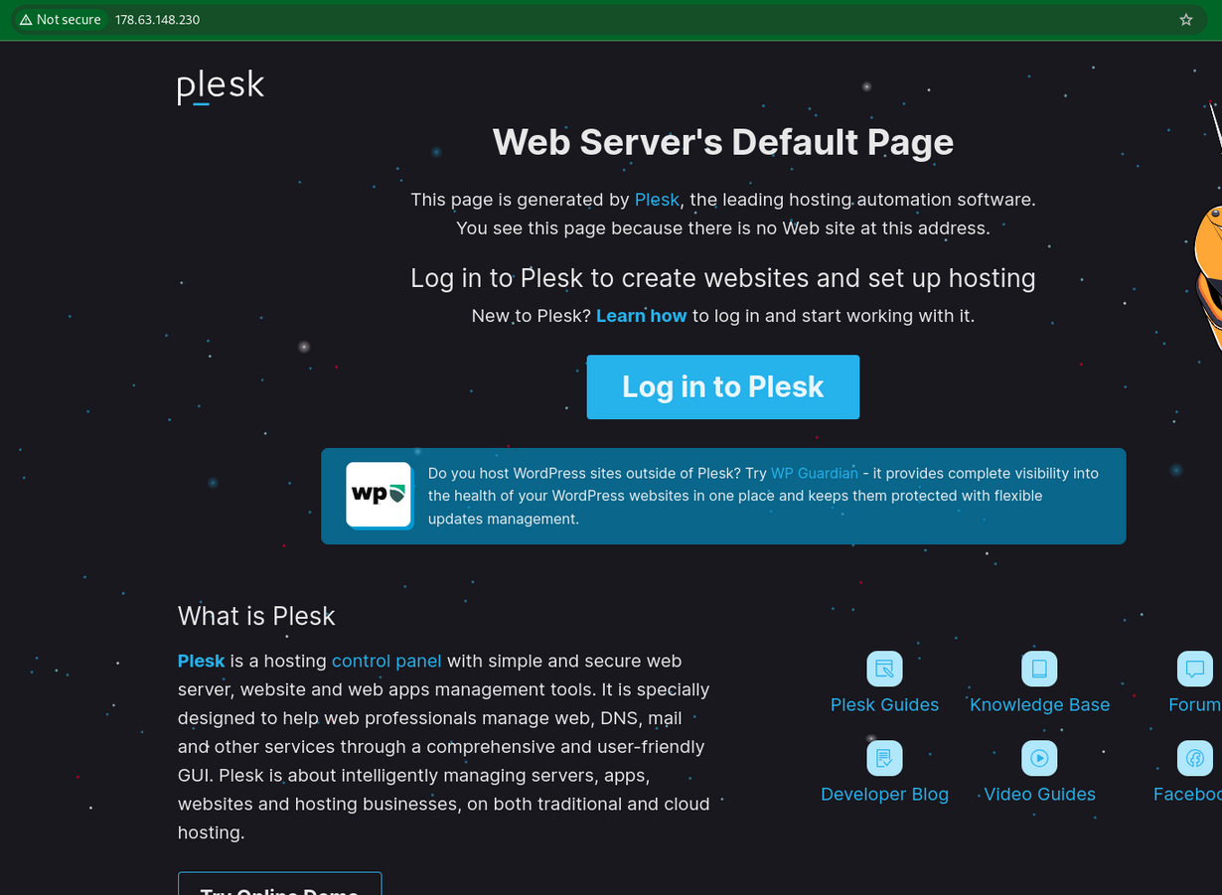
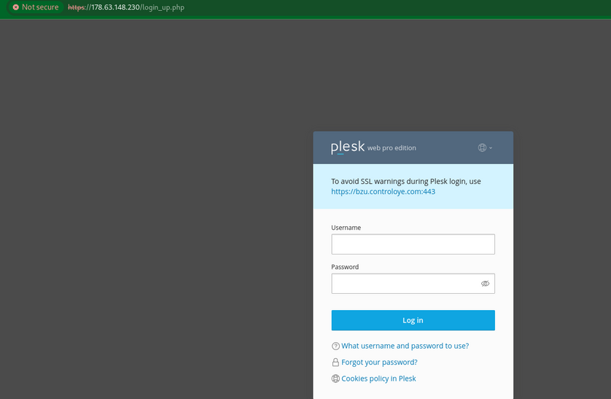
ZODFROMDEEPWEB.COM
Extras
Additional In
SLIDE
05

Slide 6
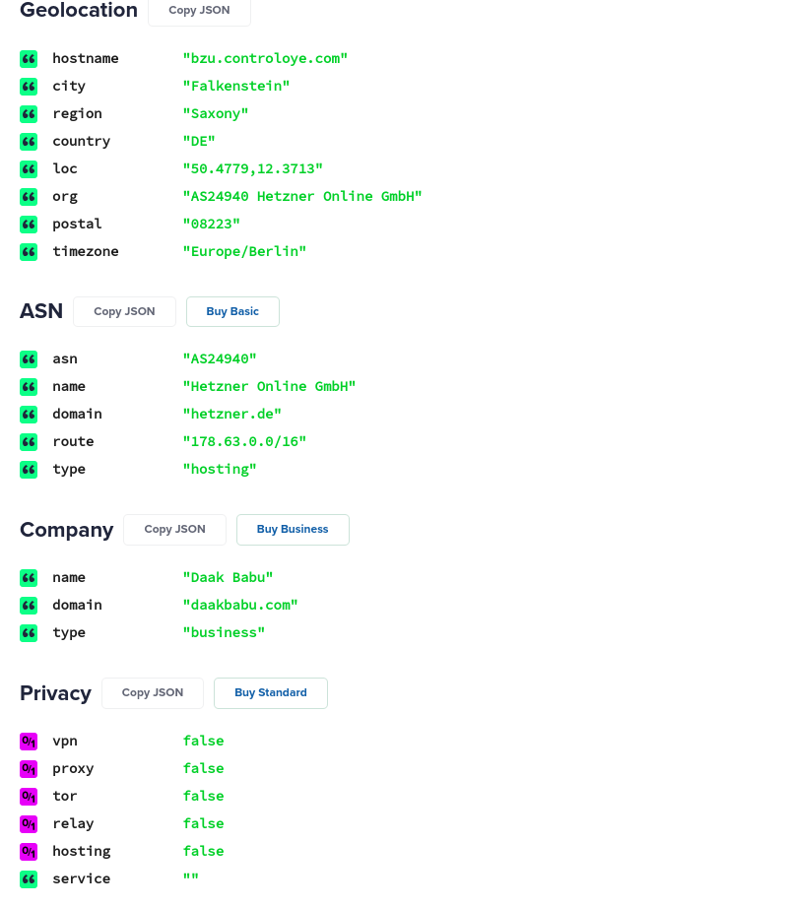
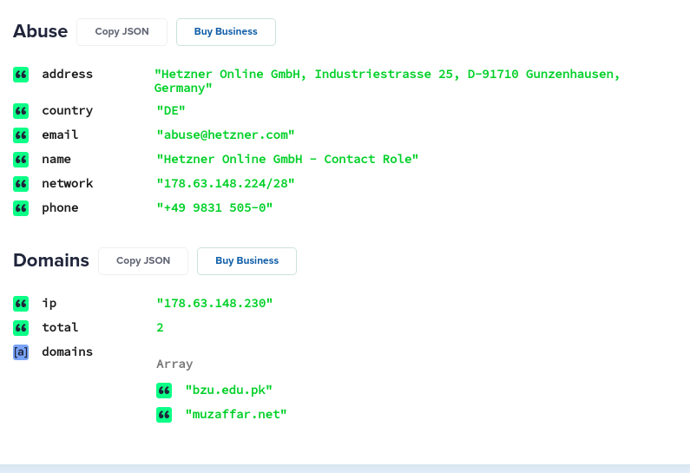
General
ZODFROMDEEPWEB.COM
Extras
Additional In
SLIDE
05

Slide 7
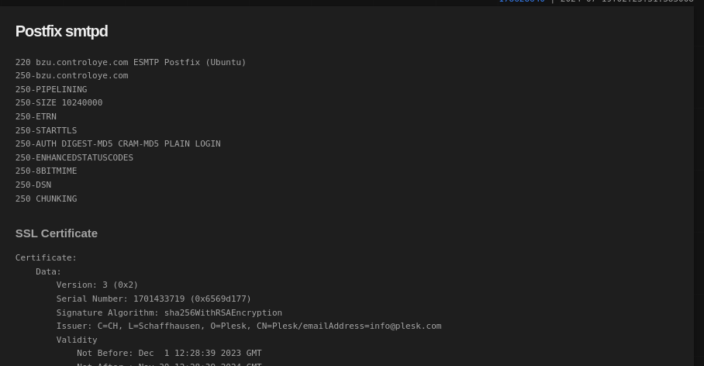
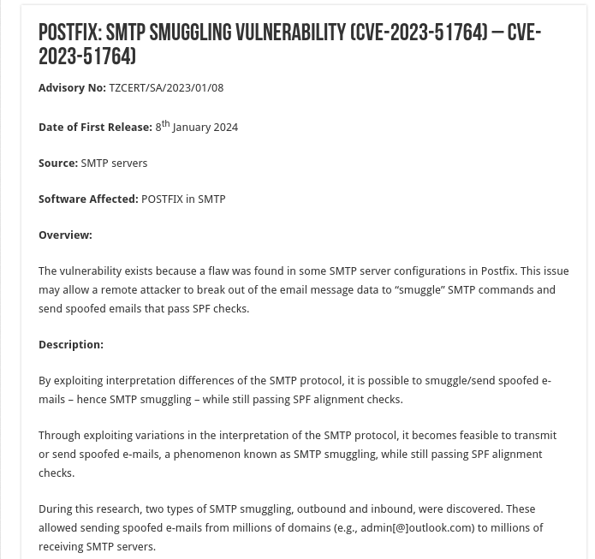
Vulnerability

Slide 8
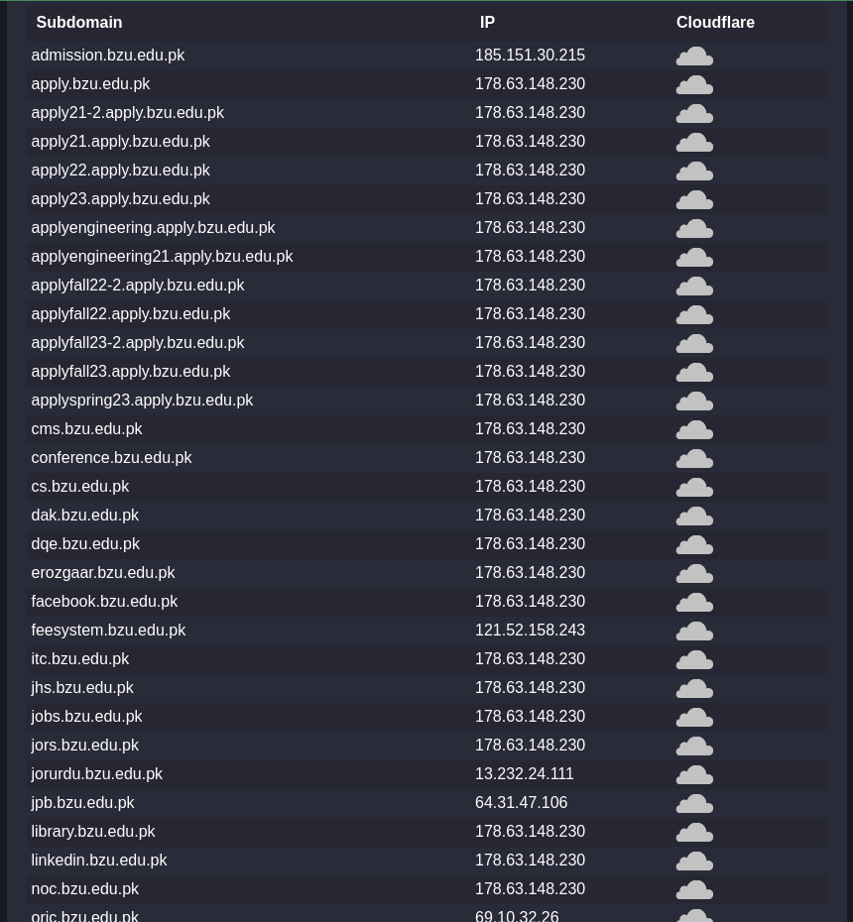
Popular
Subdomains

Slide 9

ZODFROMDEEPWEB.COM
Thank You
@GENERAL ZODX
SLIDE
END

